Slide 1
Movie Lens
A Journey Through Cinematic Innovation
Vinay Singla
2110991994
G19

Slide 2
Introduction
In the ever-evolving landscape of entertainment and digital technology, the experience of watching movies has become more than a mere pastime; it has transformed into a profound journey of personalization and immersion. It is in this exciting era of cinematic exploration that our movie app project takes center stage, offering an innovative and captivating platform for film aficionados. This comprehensive report is a testament to the vision, collaboration, and tireless dedication that have brought to life an application poised to reshape how we connect with cinema.
In a world where streaming services present a boundless array of content choices, our movie app seeks to stand out as a beacon of user-centric design, accessibility, and data-driven personalization. Its mission is not just to provide access to movies but to serve as a trusted companion, guiding users through a vast cinematic universe, introducing them to hidden gems, and forging a deeper connection to the art of storytelling.
As we delve deeper into the project, we invite you to explore an odyssey that goes beyond the realm of cinema. It is a journey marked by creativity, innovation, and a shared aspiration to create a cinematic experience that is as unique as it is unforgettable

Slide 3
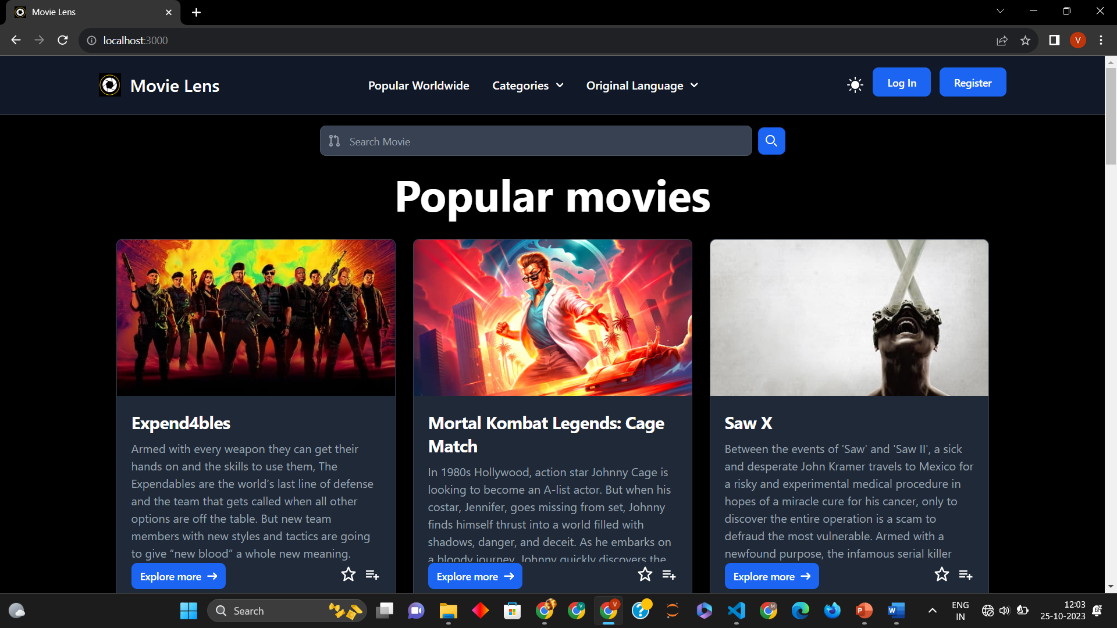
User Interface and Design
The user interface of our movie app is a canvas of elegance and functionality. Every element has been thoughtfully crafted to offer users an immersive and intuitive experience. A responsive design ensures that our app adapts seamlessly to various devices, from the largest desktop screens to the smallest mobile displays.
One of the standout features of our app is the ability for users to personalize their visual journey. We've integrated dark mode and light mode, allowing users to choose the aesthetic that best suits their mood and environment. It's a small touch, but one that underscores our commitment to enhancing the user experience.

Slide 4
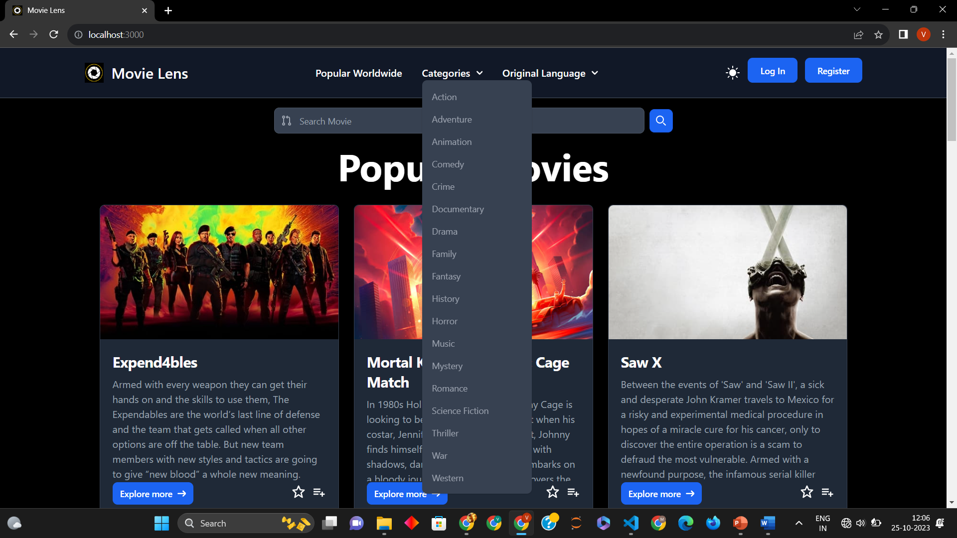
Functional Features
Movie Filtering: Our movie app boasts advanced filtering options, enabling users to explore films by genre and language. A user-friendly search bar simplifies the process of finding specific titles.

Slide 5
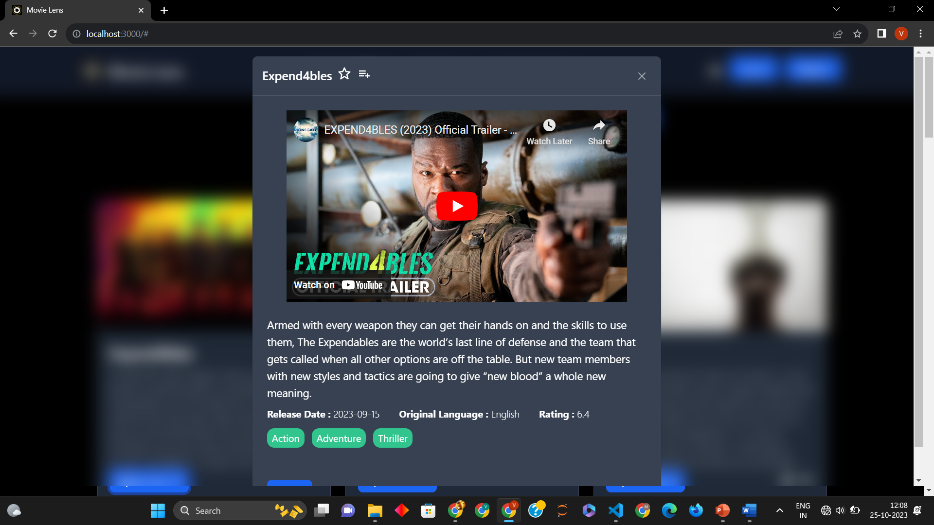
Explore More Feature: The "Explore More" feature is a portal to a deeper understanding of each movie. It offers in-depth information about the cast and crew, plot synopses, and movie trailers sourced from YouTube. This feature enriches the user's connection to the film.

Slide 6
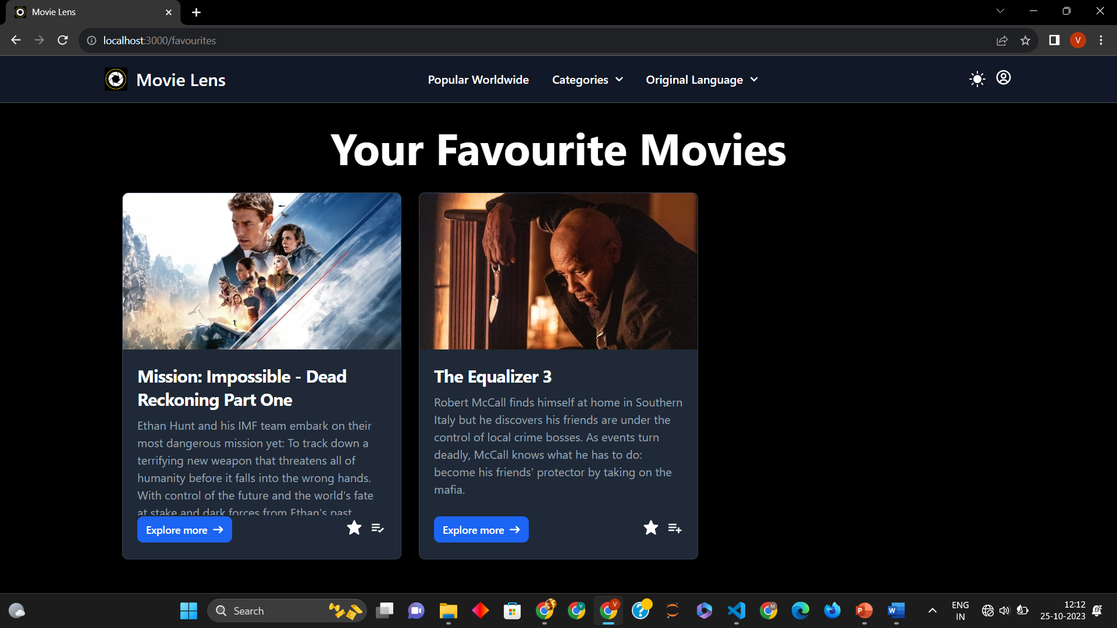
Add to Favorite/Watchlist: Building upon the idea of a personalized cinematic journey, our app empowers users to curate their movie collections. With the "Add to Favorite" and "Add to Watchlist" features, users can mark movies that resonate with them. Adding a film to their favorites is an expression of their cinematic love, while the watchlist serves as a reminder of movies they intend to see in the future. These features enhance personalization and convenience, allowing users to keep track of their cinematic preferences and never miss a movie they've been eager to watch.

Slide 7
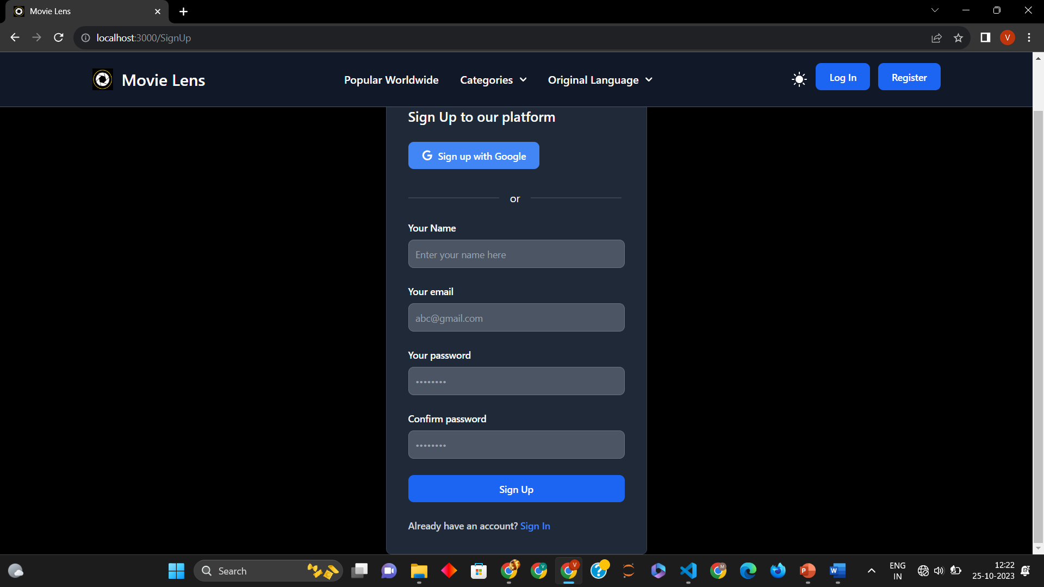
User Management
Creating user accounts is the initial step towards a personalized and secure cinematic journey. User data is securely stored and managed through Firebase, ensuring that user information remains accessible across multiple devices. Whether you're accessing the app from your smartphone, tablet, or computer, your account is your gateway to a tailored movie experience.

Slide 8
Security and Authentication
Security and authentication are the cornerstone of our movie app's user experience. We've carefully implemented robust measures to ensure that user data is safeguarded and interactions are secure
Firebase Integration: Firebase is the linchpin of our security and authentication measures. It manages user authentication, data storage, and real-time data synchronization, creating a secure and seamless user experience.
Email Validation and Password Reset: To enhance security, the app employs email validation, confirming the authenticity of user email addresses. Users can also securely reset their passwords through Firebase's password reset functionality, ensuring a smooth account recovery process.

Slide 9
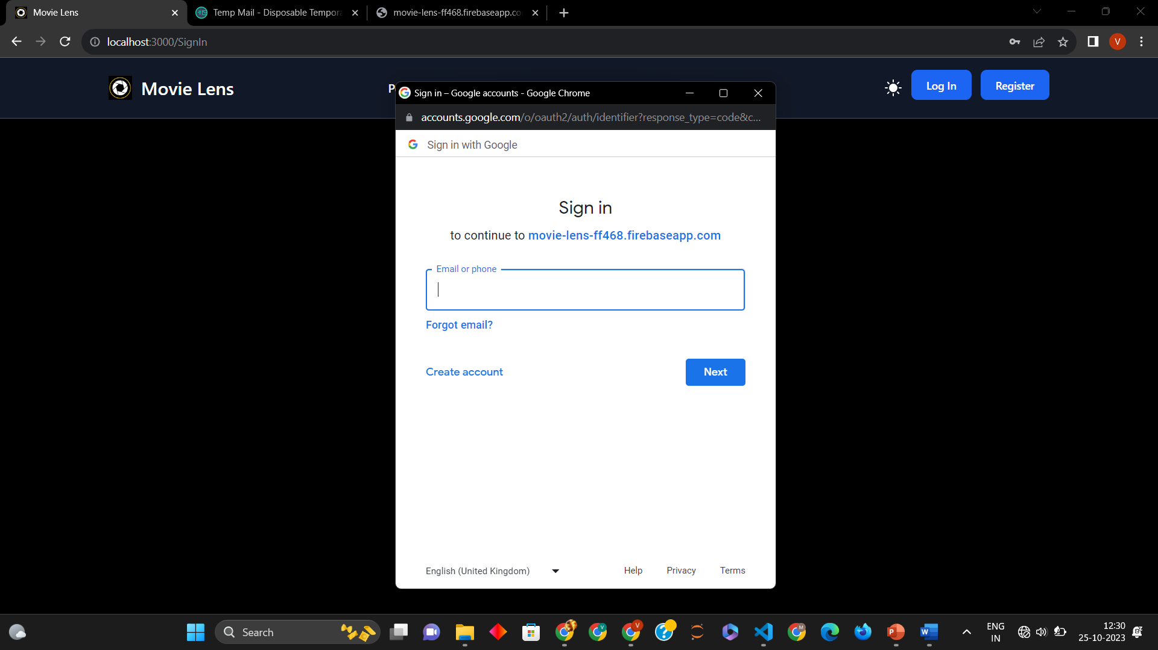
Google Sign-In: As part of our commitment to user convenience, the app offers users the option to sign in using their Google accounts. This feature streamlines the registration process and enhances onboarding, making the user experience even more seamless.

Slide 10
Technology Stack
The foundation of the movie app's functionality lies in its technology stack, comprising a set of cutting-edge tools, frameworks, and libraries. Each component has been carefully chosen to fulfill specific roles in the project. Here's a comprehensive overview:
React js: React.js serves as the core library for building the frontend of the app. Its component-based architecture ensures modularity, making it easier to develop and maintain the app's interface.
Firebase: Firebase is at the heart of the backend. It manages user authentication, stores user data, and enables real-time data updates, creating a seamless and secure user experience.

Slide 11
TMDb API: The integration with The Movie Database (TMDb) API provides the app with an extensive movie database, ensuring that users have access to up-to-date information, encompassing various genres, languages, and release years.
YouTube API: The app leverages the YouTube API to fetch and embed movie trailers, making them readily available for users. This feature enhances the user experience by offering a sneak peek into the movies.
Tailwind CSS: Tailwind CSS has been used for styling the app, allowing for the creation of clean, efficient, and responsive user interfaces.
Google Sign-In API: The Google Sign-In API streamlines the registration process, enabling users to sign in conveniently using their Google accounts.

Slide 12
Challenges
The journey of developing our movie app was not without its challenges. These obstacles, while demanding, represented opportunities for growth and learning. I encountered a range of technical complexities, each requiring inventive solutions:
API Integration: One significant challenge was integrating multiple APIs seamlessly. Coordinating data flow and maintaining synchronization across different platforms required meticulous planning and coding expertise.
App Performance Optimization: As the app's features expanded, optimizing its performance to deliver a responsive and fluid user experience became a complex task. Balancing functionality with speed and efficiency was a constant consideration.

